Slide 1
Reinforcement Learning for Inventory Optimization
Larry Snyder
Professor, Industrial and Systems Engineering
Director, I-DISC
RL for Operations Summer Bootcamp
Northwestern University, Aug. 18, 2022

Slide 2

Slides are on GitHub repo
github.com/LarrySnyder/RLforInventory
Click slides

Slide 3

https://youtu.be/TmPfTpjtdgg

Slide 6
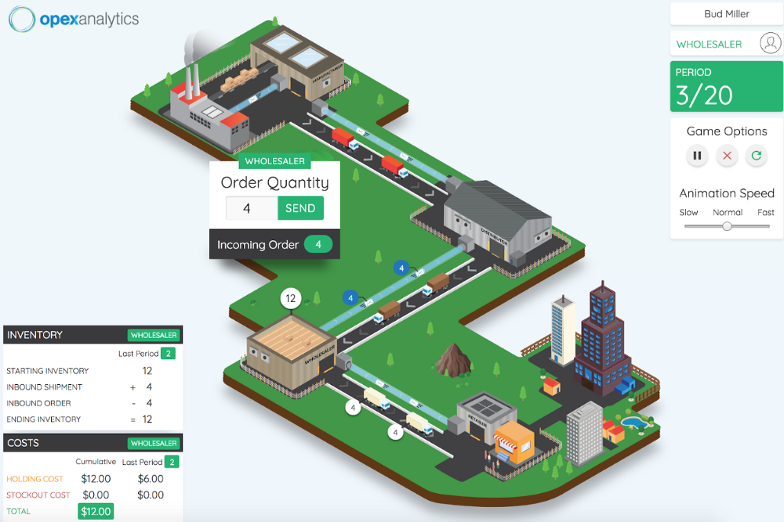
The beer game

Slide 7
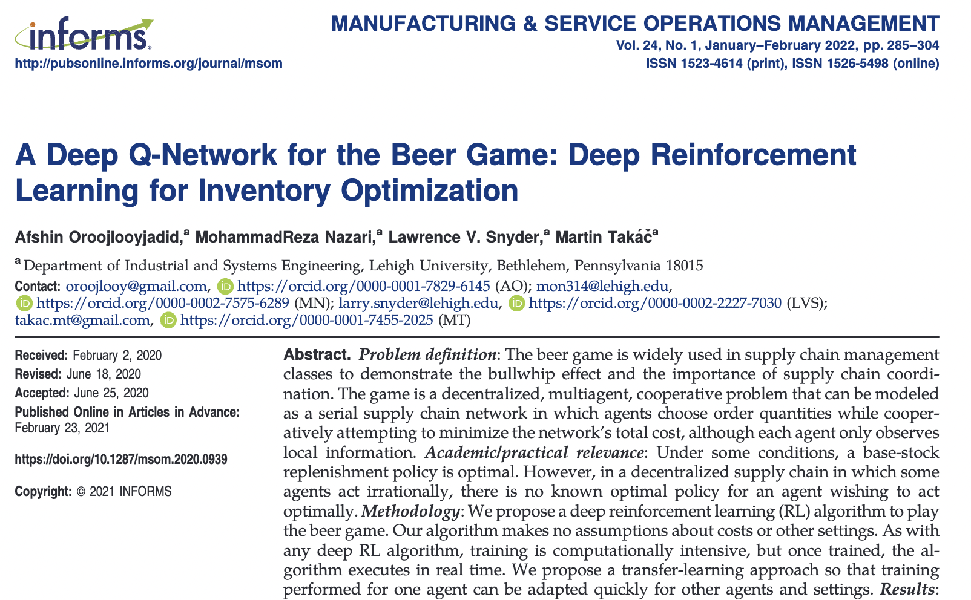

Slide 8
Outline
Introduction
The newsvendor problem as a multi-armed bandit
The multi-period newsvendor problem as an MDP
The beer game as a deep RL problem

Slide 9
Introduction
Part 0

Slide 10
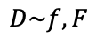
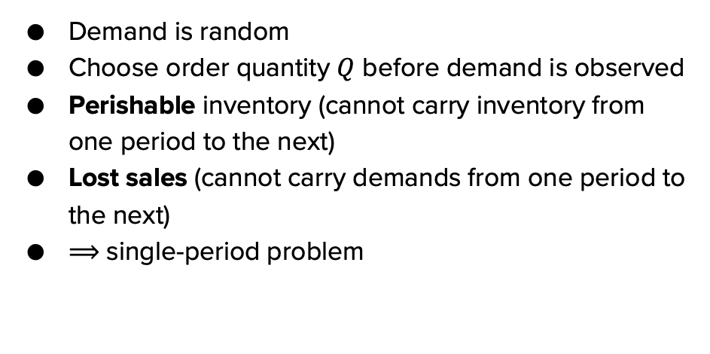
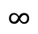
The newsvendor problem
Demand is random
Choose order quantity $Q$ before demand is observed
Perishable inventory (cannot carry inventory from one period to the next)
Lost sales (cannot carry demands from one period to the next)
$⟹$ single-period problem
$$∞$$
$$D\sim f,F$$

Slide 11
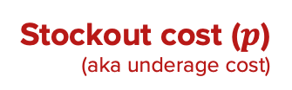
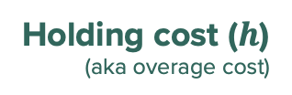
The newsvendor problem
Holding cost ($h$)
(aka overage cost)
How many newspapers
to have on hand today?
$0.15 / extra newspaper
Stockout cost ($p$)
(aka underage cost)
$0.70 / unmet demand
$$∞$$
$$D\sim f,F$$

Slide 12
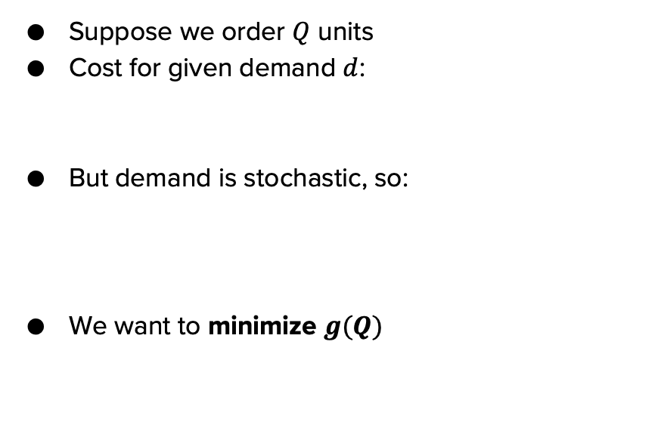
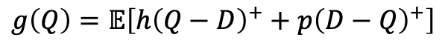
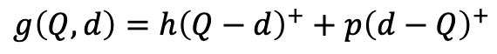
The newsvendor problem: Formulation
Suppose we order $Q$ units
Cost for given demand $d$:
But demand is stochastic, so:
We want to minimize $g(Q)$
$$g\left(Q,d\right)=h{\left(Q−d\right)}^{+}+p{\left(d−Q\right)}^{+}$$
$$g\left(Q\right)=𝔼\left[h{\left(Q−D\right)}^{+}+p{\left(D−Q\right)}^{+}\right]$$

Slide 13
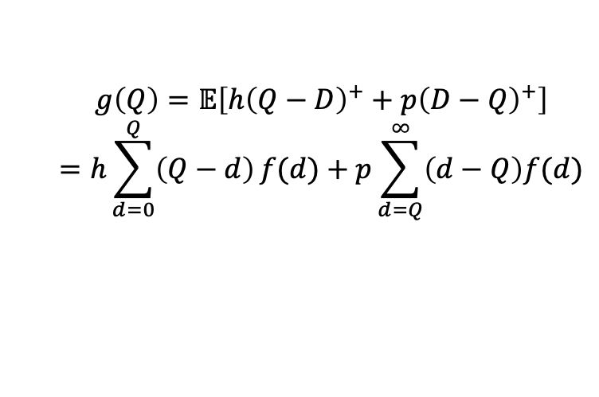
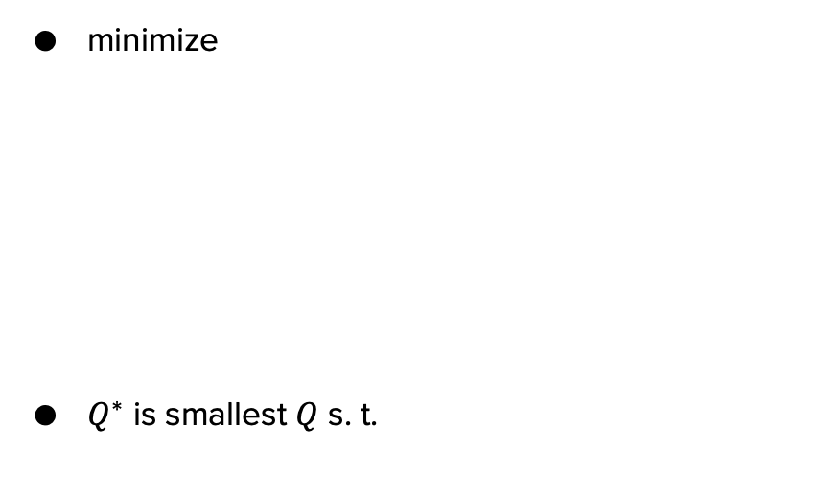
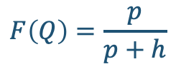
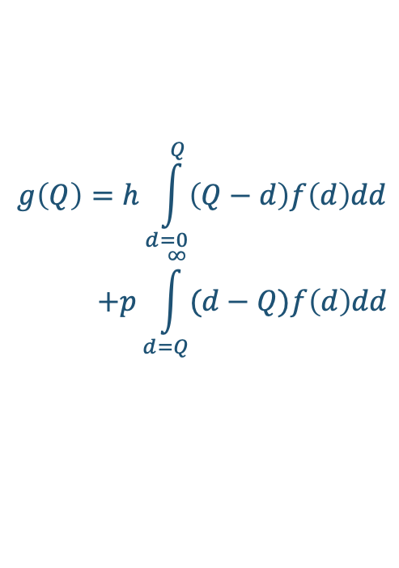
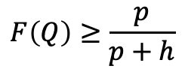
The newsvendor problem: Optimal solution
Continuous demand distribution:
$$g\left(Q\right)=h\int_{d=0}^{Q}{\left(Q−d\right)f\left(d\right)dd}$$
$$+p\int_{d=Q}^{∞}{(d−Q)f\left(d\right)dd}$$
minimize
$Q^{∗}$ is smallest $Q$ s. t.
$$g\left(Q\right)=𝔼\left[h{\left(Q−D\right)}^{+}+p{\left(D−Q\right)}^{+}\right]$$
$$=h\sum_{d=0}^{Q}{\left(Q−d\right)}f(d)+p\sum_{d=Q}^{∞}{\left(d−Q\right)f(d)}$$
[…algebra happens…]
[…calculus happens…]
$$F\left(Q\right)≥\frac{p}{p+h}$$
$$F\left(Q\right)=\frac{p}{p+h}$$

Slide 14
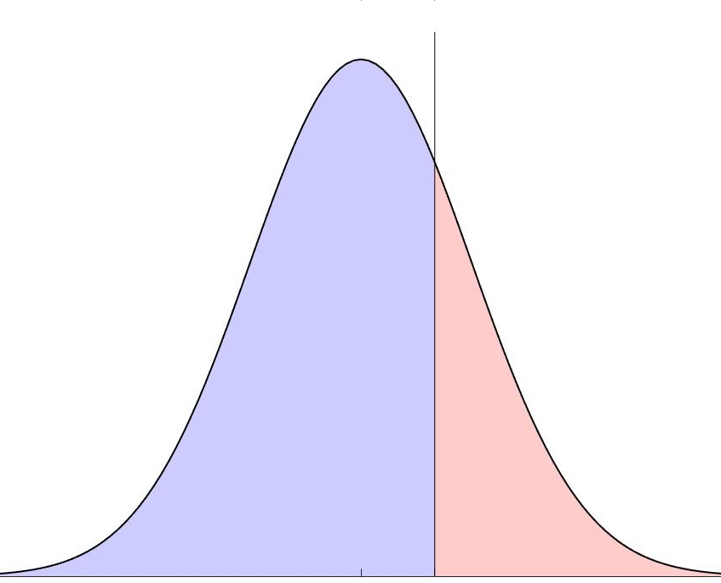
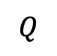
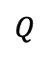
The newsvendor problem: Intuition
expected cost
unmet demand, pay stockout cost
excess inventory, pay holding cost
$$Q$$
$$Q$$
possible demand values

Slide 15
RL for the newsvendor problem
RL is overkill for the newsvendor problem
Little or no use of RL in the newsvendor literature
ML approaches for newsvendor with features:
Empirical quantile: Bertsimas and Thiele (2005)
k-nearest neighbor, random forest: Bertsimas and Kallus (2014)
Kernel regression, SVM: Ban and Rudin (2018)
Kernelized ERM: Notz and Pibernik (2020)
DNN: Oroojlooyjadid, LVS, and Takáč (2020)
Other data-driven approaches (no features):
Censored data: Besbes and Muharremoglu (2013)
Pricing + inventory: Burnetas and Smith (2000)

Slide 16
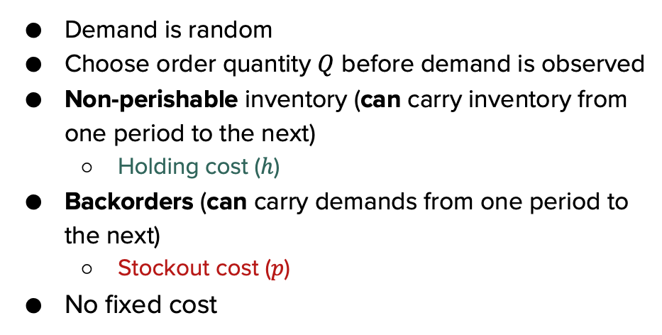
The multi-period newsvendor (MPNV) problem
Demand is random
Choose order quantity $Q$ before demand is observed
Non-perishable inventory (can carry inventory from one period to the next)
Holding cost ($h$)
Backorders (can carry demands from one period to the next)
Stockout cost ($p$)
No fixed cost
$$∞$$
$$D\sim f,F$$

Slide 17
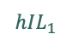
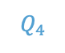
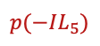
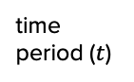
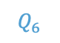
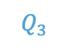
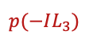
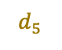
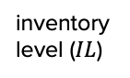
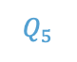
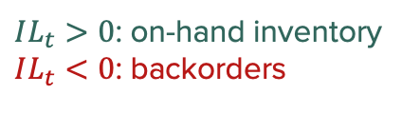
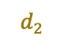
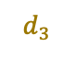
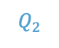
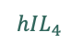
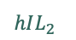
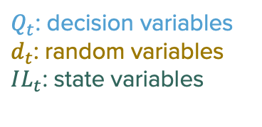
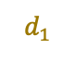
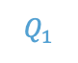
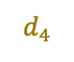
The MPNV: Inventory dynamics
$Q_{t}$: decision variables
$d_{t}$: random variables
$IL_{t}$: state variables
inventory level ($IL$)
$IL_{t}>0$: on-hand inventory
$IL_{t}<0$: backorders
$$d_{2}$$
$$Q_{3}$$
$$Q_{2}$$
$$Q_{5}$$
$$Q_{1}$$
$$d_{1}$$
$$d_{5}$$
$$hIL_{2}$$
$$d_{3}$$
$$d_{4}$$
$$Q_{6}$$
$$Q_{4}$$
$$hIL_{1}$$
$$hIL_{4}$$
time period ($t$)
$$p(−IL_{3})$$
$$p(−IL_{5})$$

Slide 18
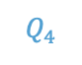
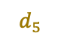
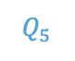
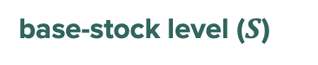
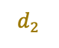
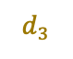
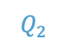
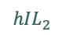
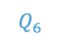
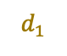


It turns out …
a base-stock policy is optimal
inventory level ($IL$)
base-stock level ($S$)
$$d_{2}$$
$$Q_{3}$$
$$Q_{1}$$
$$Q_{2}$$
$$d_{1}$$
$$Q_{5}$$
$$d_{4}$$
$$d_{5}$$
$$Q_{6}$$
$$hIL_{2}$$
$$d_{3}$$
$$Q_{4}$$
$$hIL_{1}$$
$$hIL_{4}$$
time period ($t$)
$$p(−IL_{3})$$
$$p(−IL_{5})$$

Slide 19







Base-stock policies
$$Q=\left\{\begin{matrix}S−x & x≤S \\ 0 & x>S\end{matrix}\right.$$
In period $t$, order: where $x$ = ending IL in period $t−1$ = starting IL in period $t$
order quantity
order-up-to level
$$S$$
$$S$$
$$S$$
$$x$$
$$S$$
$$x$$

Slide 20






“Policy”
In RL, a policy is a mapping from states to actions:
In inventory theory, a policy is a simple rule that describes the mapping:
$$π(s)$$
$$s$$ | $$−5$$ | $$−4$$ | $$−3$$ | $$−2$$ | $$−1$$ | $$0$$ | $$1$$ | $$2$$ | $$3$$ | $$4$$ | $$5$$
$$π(s)$$ | $$12$$ | $$7$$ | $$4$$ | $$9$$ | $$5$$ | $$3$$ | $$0$$ | $$6$$ | $$5$$ | $$0$$ | $$9$$
$$s$$
$$Q$$
$$Q=\left\{\begin{matrix}S−x & x≤S \\ 0 & x>S\end{matrix}\right.$$
$$x$$

Slide 21






Three flavors of MPNV
$$\min{\sum_{t=1}^{T}{g_{t}\left(Q_{t}\right)}}$$
Base-stock optimal
Find $S_{t}$ using DP
Finite horizon:
Infinite horizon, discounted cost:
Infinite horizon, average cost:
$$\min{\sum_{t=1}^{∞}{γ^{t−1}g_{t}\left(Q_{t}\right)}}$$
Base-stock optimal
Analytical solution for $S$
$$\min{g(Q) }$$
Base-stock optimal
Analytical solution for $S$

Slide 22



The MPNV: Optimal solution
For infinite-horizon, average cost: If we use a base-stock level of $S$:
Same form as (single-period) newsvendor!
$⟹ S^{∗}$ is smallest $S$ such that
Similar for infinite-horizon, discounted cost
$$g\left(S\right)=𝔼\left[h\sum_{d=0}^{S}{(S−D)}+p\sum_{d=S}^{∞}{(D−S)}\right]$$
$$F\left(S\right)≥\frac{p}{p+h}$$

Slide 23

RL for the MPNV
Again, MPNV is easy $⟹$ we don’t need RL
But some variants are hard
Lost sales and non-zero lead time
Gijsbrechts, et al. (2022): DRL
Balaji, et al. (2020): PPO
Dual sourcing with different lead times:
Gijsbrechts, et al. (2022): DRL
Distributed energy storage:
Dada, et al. (2022): MARL

Slide 24




Multi-echelon inventory optimization (MEIO)
Nodes (stages) may represent locations or processes
For most network structures, form of optimal policy is unknown
Let alone optimal policy parameters
Some special cases are well understood
$$∞$$
$$D\sim f,F$$
$$∞$$
$$D\sim f,F$$

Slide 25
Multi-echelon inventory optimization (MEIO)
Two main flavors:
Stochastic-service models (SSM): satisfy as much demand as possible, backorder the rest; LT may be stochastic due to stockouts
Guaranteed-service models (GSM): all demand must be satisfied (up to a bound); LT is deterministic
our focus
$$∞$$
$$D\sim f,F$$
$$∞$$
$$D\sim f,F$$

Slide 26



Serial systems
With no fixed costs, a base-stock policy is optimal (Clark and Scarf 1960)
Finding optimal base-stock levels is cumbersome (Chen and Zheng 1994)
Sequential minimization of single-variable convex functions
Numerical integration/expectation
Good heuristics exist (e.g., Shang and Song 2003)
All methods are very “fragile”—dependent on assumptions/settings
$$∞$$
$$⋯$$
$$D\sim f,F$$

Slide 27
RL for MEIO
One-warehouse, multi-retailer (OWMR) system:
Gijsbrechts, et al. (2022): DRL
Vendor-managed inventory (VMI):
Sui, Gosavi, and Lin (2010): Q-learning w/Q-function approximation
Beer game (serial system):
Oroojlooyjadid, et al. (2022): DRL
(Not quite MEIO)

Slide 28

Centralized vs. decentralized control
So far, we have assumed centralized control
One decision maker can set all the inventory policies

Slide 29



Centralized vs. decentralized control
Many real-life systems use decentralized control
Each node managed by a different agent
Could be a competitor
$⟹$ game theory, supply chain contracts, etc.
Or a partner (with imperfect info)
$⟹$ beer game

Slide 30



Centralized vs. decentralized control
What to do if this is your situation?

Slide 31





Inventory theory: References
Zipkin (2000)
Porteus (2002)
Axsäter (2016)
Vandeput (2020)
Snyder and Shen (2019)

Slide 32



stockpyl
pypi.org/project/stockpyl/
Download / install
stockpyl.readthedocs.io/en/latest/
Documentation
github.com/LarrySnyder/stockpyl
Source code
Bug reports, etc.

Slide 33
stockpyl: Single-echelon inventory optimization
EOQ:
Newsvendor:
>>> from stockpyl.eoq import economic_order_quantity
>>> Q, cost = economic_order_quantity(fixed_cost=8, holding_cost=0.225, demand_rate=1300)
>>> Q
304.0467800264368
>>> cost
68.41052550594829
>>> from stockpyl.newsvendor import newsvendor_normal
>>> S, cost = newsvendor_normal(holding_cost=0.18, stockout_cost=0.70, demand_mean=50, demand_sd=8)
>>> S
56.60395592743389
>>> cost
1.9976051931766445

Slide 34
stockpyl: Single-echelon inventory optimization
Wagner-Whitin:
>>> from stockpyl.wagner_whitin import wagner_whitin
>>> T = 4
>>> h = 2
>>> K = 500
>>> d = [90, 120, 80, 70]
>>> Q, cost, theta, s = wagner_whitin(T, h, K, d)
>>> Q # Optimal order quantities
[0, 210, 0, 150, 0]
>>> cost # Optimal cost
1380.0
>>> theta # Cost-to-go function
array([ 0., 1380., 940., 640., 500., 0.])
>>> s # Optimal next period to order in
[0, 3, 5, 5, 5]

Slide 35
stockpyl: Single-echelon inventory optimization
Finite-horizon stochastic inventory problems (via DP):
>>> from stockpyl.finite_horizon import finite_horizon_dp
>>> T = 5
>>> h = 1
>>> p = 20
>>> h_terminal = 1
>>> p_terminal = 20
>>> c = 2
>>> K = 50
>>> mu = 100
>>> sigma = 20
>>> s, S, cost, _, _, _ = finite_horizon_dp(T, h, p, h_terminal, p_terminal, c, K, mu, sigma)
>>> s # Reorder points
[0, 110, 110, 110, 110, 111]
>>> S # Order-up-to levels
[0, 133.0, 133.0, 133.0, 133.0, 126.0]

Slide 36
stockpyl: MEIO
Chen and Zheng (1994) (based on Clark and Scarf (1960)) for serial systems:
>>> from stockpyl.supply_chain_network import serial_system
>>> from stockpyl.ssm_serial import optimize_base_stock_levels
>>> network = serial_system( # Build network.
... num_nodes=3,
... node_order_in_system=[3, 2, 1],
... echelon_holding_cost=[4, 3, 1],
... local_holding_cost=[4, 7, 8],
... shipment_lead_time=[1, 1, 2],
... stockout_cost=40,
... demand_type='N’,
... mean=10,
... standard_deviation=2)
>>> S_star, C_star = optimize_base_stock_levels(network=network) # Optimize.
>>> print(f"Optimal echelon base-stock levels = {S_star}")
Optimal echelon base-stock levels = {3: 44.1689463285519, 2: 34.93248526934437, 1: 25.69602421013684}
>>> print(f"Optimal expected cost per period = {C_star}") Optimal expected cost per period = 227.15328525645054

Slide 37
stockpyl: MEIO
DP for GSM for tree networks (Graves and Willems 2000):
>>> from stockpyl.gsm_tree import optimize_committed_service_times
>>> from stockpyl.instances import load_instance
>>> # Load a named instance, Example 6.5 from FoSCT.
>>> tree = load_instance("example_6_5")
>>> # Optimize committed service times.
>>> opt_cst, opt_cost = optimize_committed_service_times(tree)
>>> print(f"Optimal CSTs = {opt_cst}")
Optimal CSTs = {1: 0, 3: 0, 2: 0, 4: 1}
>>> print(f"Optimal expected cost per period = {opt_cost}")
Optimal expected cost per period = 8.277916867529369

Slide 38
stockpyl: Simulation
Simulation for very general multi-echelon systems:
>>> from stockpyl.supply_chain_network import echelon_to_local_base_stock_levels
>>> from stockpyl.sim import simulation
>>> from stockpyl.policy import Policy
>>> # Convert to local base-stock levels and set nodes' inventory policies.
>>> S_star_local = echelon_to_local_base_stock_levels(network, S_star)
>>> for n in network.nodes:
... n.inventory_policy = Policy(type='BS', base_stock_level=S_star_local[n.index], node=n)
>>> # Simulate the system.
>>> T = 1000
>>> total_cost = simulation(network=network, num_periods=T, rand_seed=42)
>>> print(f"Average total cost per period = {total_cost/T}")
Average total cost per period = 226.16794575837224

Slide 39
To install
From a terminal:
From Colab/Jupyter notebook:
github.com/LarrySnyder/RLforInventory > notebooks > A_Quick_Tour_of_Stockpyl.ipynb for a short overview
(But we won’t go through this notebook today)
pip install stockpyl
!pip install stockpyl

Slide 40


Questions?
larry.snyder@lehigh.edu
https://coral.ise.lehigh.edu/larry/
Supported in part by NSF grants NSF:CCF:1618717, NSF:CMMI:1663256, NSF:CCF:1740796, and XSEDE:DDM180004.

